Slide 1
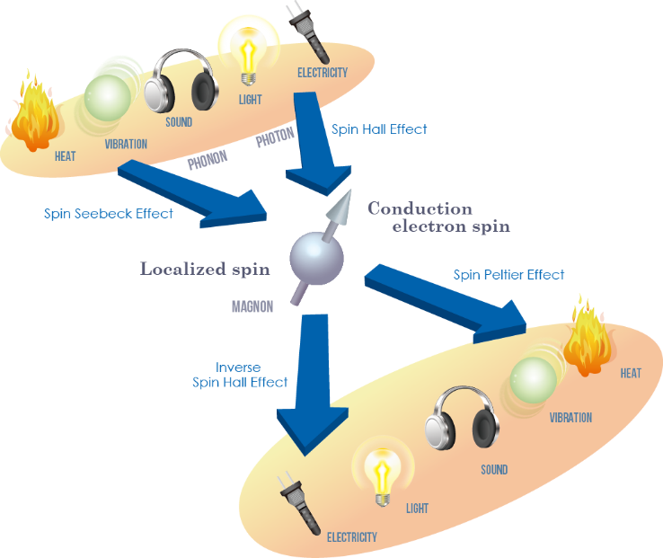
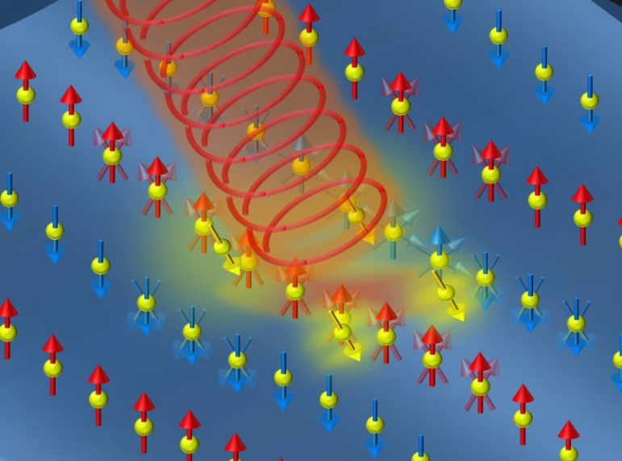
Abstract Title (example 1)
Y. Otani^{1,2}
¹RIKEN Center for Emergent Matter Science (CEMS), Wako, Saitama 351-0198, Japan
²ISSP, University of Tokyo, Kashiwa 277-8681, Japan
The international workshop on Nano-Spin Conversion Science and Quantum Spin Dynamics (NSCS-QSD 2016) is co-sponsored by KAKENHI on Innovative Area “Nano-Spin Conversion Science” and Quantum information electronics division, CEMS RIKEN. Nano-spin conversion science deals with all the interconversion phenomena among electrons, phonons, magnons, and photons mediated by spins. The aim of the workshop is to provide an international/global forum for discussions of interdisciplinary issues on “spin torque induced dynamics of spin structures such as domain walls and skyrmions”, “spin to charge interconversion phenomena due to spin Hall effects and spin momentum locking at the surface and interface states”, “optically induced collective and also coherent quantum spin dynamics” and “thermally and mechanically created spin currents”.

